Slide 1

Journal Club 6: Modeling Count
Dominic Adducci
March 13, 2024
Notes:
TIP: ”Save as” this template before you begin and rename it to the title of your presentation. That way you will retain a copy of this blank template for future use.

Slide 2
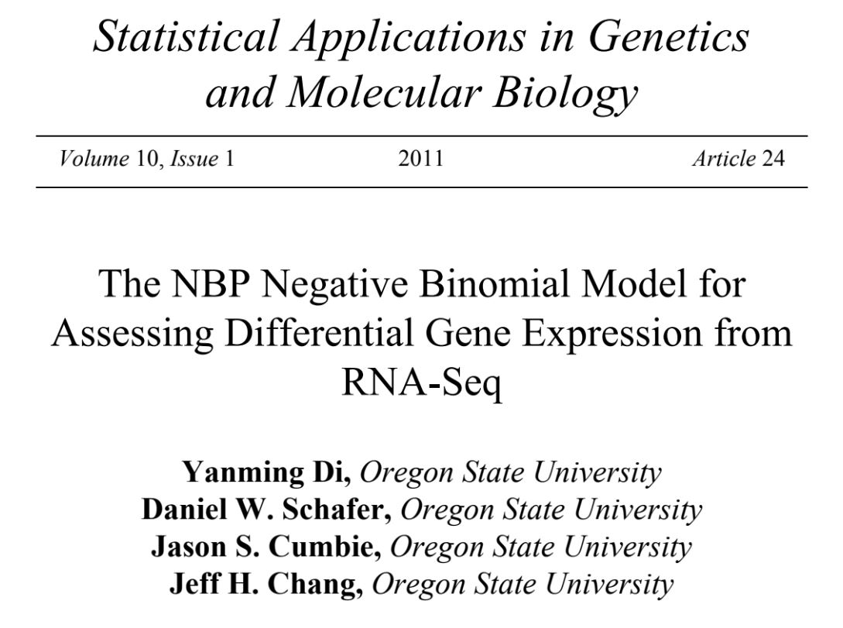
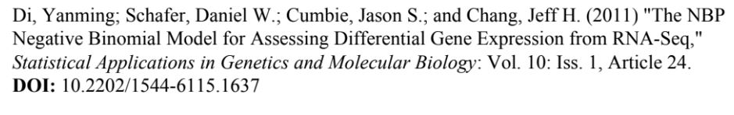

Slide 3
Outline
Introduction
RNA-Seq Data Structure and Possible Tests for Differential Gene Expression
The NBP Distribution
Adaptation of the Robinson and Smyth Exact Test
Library Size Adjustments
Arabidopsis Example
Simulations
Conclusions

Slide 4
Introduction: RNA-Seq Crash Course
High throughput RNA sequencing (RNA-Seq) measures gene expression
Isolate and randomly fragment mRNA
Covert mRNA to complementary DNA (cDNA)
Prepare cDNA for sequencing
cDNA sequencing produces hundreds of millions of short RNA-Seq reads
These RNA-Seq reads are aligned to a reference database
The relative frequency of RNA-Seq reads that match a gene measure a gene’s expression

Slide 5
Introduction – The Problem
Identification of differentially expressed genes between two groups using counts…Simple???
3 key problems:
A very large number of genes to be tested
Small number of biological samples
Count variability that does not follow binomial or Poisson distributions
Small number of biological samples precludes asymptotic based methods

Slide 6
Introduction – The Solution
Robinson and Smyth proposed negative binomial distribution
Offers a more realistic model for RNA-Seq count variability that the Poisson distribution
Permits an exact (non-asymptotic) test for comparing two groups
Saving of statistical power from estimating negative binomial dispersion parameter from all genes combined*
* Constant dispersion parameter not realized for RNA-Seq data sets examined
Several approaches between single dispersion parameter and separate dispersion parameters

Slide 7
Introduction – Modeling Approaches
Comparison between several approaches
Dispersion modeling approaches
edgeR multiple options (trend, moderated common) – uses empirical Bayes to shrink genewise dispersion estimates towards a constant value
DESeq – dispersion parameter modeled as a smooth function of the mean, used nonparametric regression to fit NB variance as function of the mean
NBP – non-constant dispersion parameter directly within a parametric family
Naive approaches
Poisson
Two-sample t-test
Negative binomial with constant dispersion parameter
Authors approach was NBP – relative transparency, model simplicity, absence of user-specified tuning parameters for statistical fitting

Slide 8
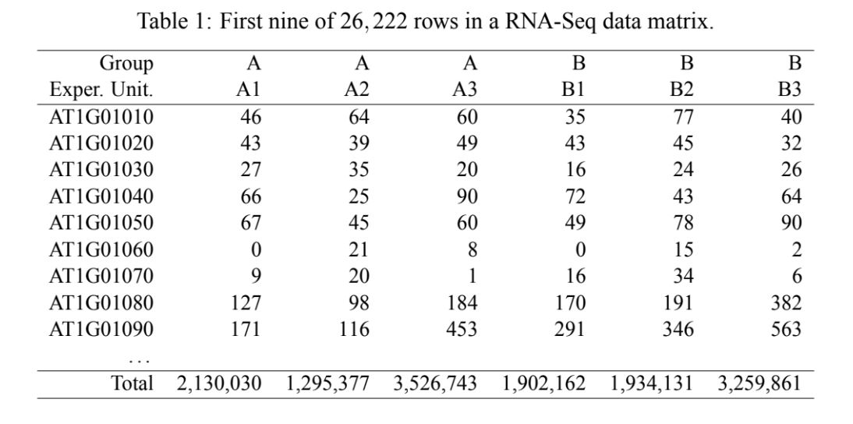
RNA-Seq Data and Tests
Table – Example of RNA Seq data
Columns are response vectors for individual response units (biological samples) – 6 total
Cell values are frequency of RNA-Seq reads that match genes for each row
Last row number of mappable RNA-seq reads for each sample – active library sizes
Two groups in this example – Arabidopsis thaliana

Slide 9
RNA-Seq Relative Frequency
Authors note that gene expression in this paper is indicated by relative frequency.
Potential problem in analysis:
Only one gene is truly differentially expressed
Higher relative frequency of reads for one gene must be accompanied by lower relative frequency of other genes
This is because relative frequencies must sum to 1, even if other genes not truly differentially expressed
Authors state that this is a negligible issue, as relative frequencies are generally spread across many genes
Normalization not used in this example, but could still be applicable

Slide 10
RNA-Seq Model Start
Random vector of RNA-Seq reads for observational unit
Observational unit – biological sample
Condition on the total number of RNA-Seq reads for unit
Multinomial model for entire column
Binomial model for individual cell in a column
Poisson approximation to the binomial distribution

Slide 11
RNA-Seq Expected Count
$$E\left(Y_{ijk} | m_{jk}\right)=μ_{ik}=m_{jk}π_{ik}$$
Y_{ijk} = random variable for number of RNA-Seq reads for gene i from observational unit j, in treatment group k
m_{jk} = total number of RNA-Seq reads for observational unit j within group k (active library size)
µ_{ik} = expected number of genes i in group k (relative frequency)
Π_{ik} = proportion of genes i in group k

Slide 12
RNA-Seq Poisson and NB
Differential expression is established if π_{i1} is significantly different from π_{i2} for gene i
Poisson variance significantly greater than mean – overdispersion
Negative Binomial (NB) distribution can be thought of as a gamma mixture of Poisson distributions

Slide 13
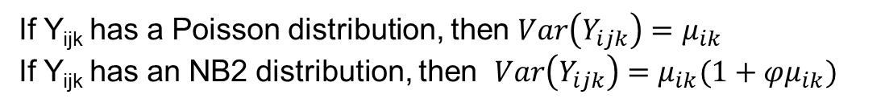
RNA-Seq Robinson and Smyth – NB2 Distribution
If Y_{ijk} has a Poisson distribution, then $Var\left(Y_{ijk}\right)=μ_{ik}$
If Y_{ijk} has an NB2 distribution, then $Var\left(Y_{ijk}\right)=μ_{ik}(1+φμ_{ik})$
The φ parameter models biological variability
Test based on known φ far more powerful than test based on estimated φ, due to small sample size
Assuming a constant φ across genes equivalent to a known φ
This assumption does NOT hold for many data sets

Slide 14
RNA-Seq NBP Distribution
If Y_{ijk} has an NBP distribution, then $Var\left(Y_{ijk}\right)=μ_{ik}(1+φμ_{ik}^{α−1})$
Solution proposed by authors is the NBP distribution
NB2 is a specific version of NBP where α = 2
Two parameters of φ and α are estimated from all genes combined, and subsequently treated as known, saving statistical power

Slide 15
RNA-Seq DESeq Method
Anders and Huber approach (DESeq): $Var\left(Y_{ijk}\right)=μ_{ik}(1+φ_{μ}μ_{ik})$
DESeq method generalizes the Robinson and Smyth approach by incorporating relationship between φ and α
A nonparametric regression estimates dependence of φ on α
“trend” option in EdgeR incorporates nonparametric regression modeling of φ_{μ} within an empirical Bayes estimation scheme.

Slide 16
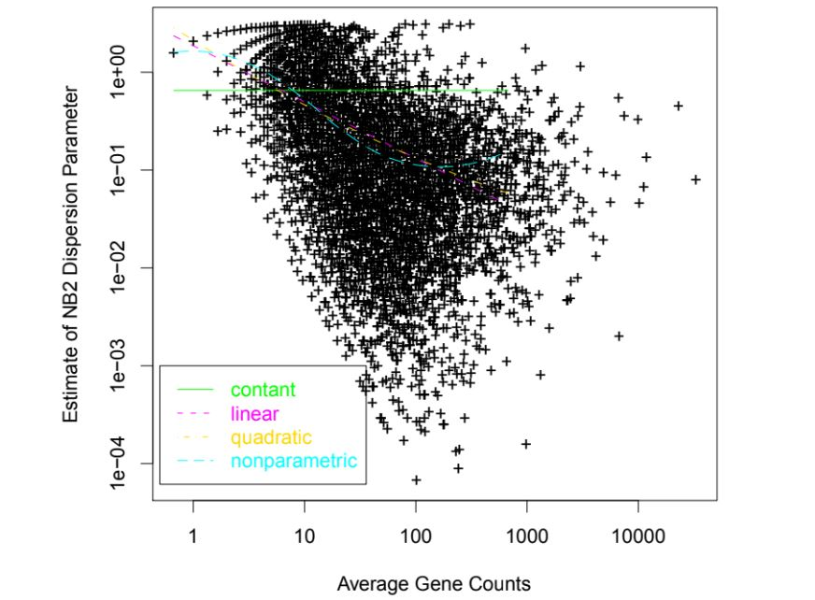
RNA-Seq Figure 1

Slide 17
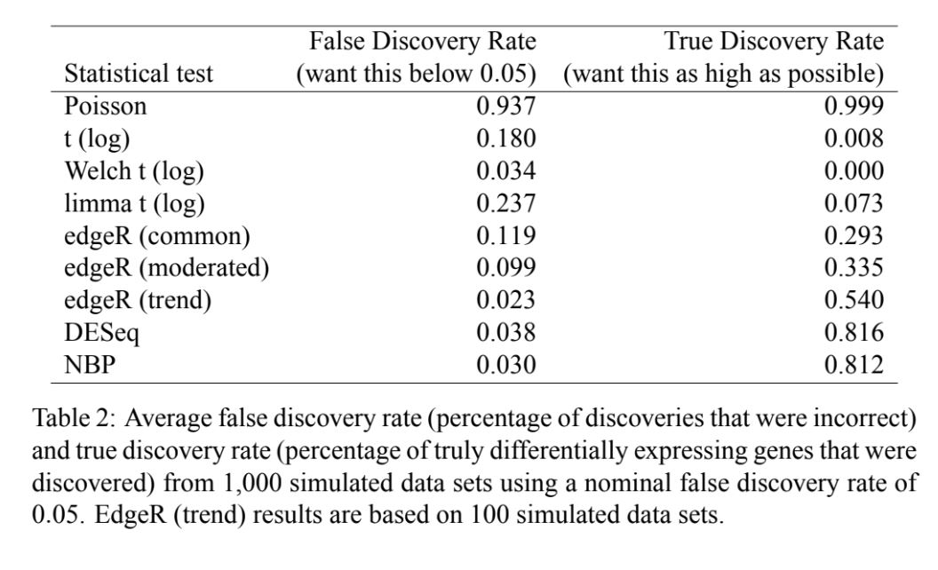
RNA-Seq Table 2

Slide 18
NBP Distribution
Previous work established the NBP distribution [Greene (2008) and Hilbe (2008)], but application was not assessed
Consider NBP model as a gamma mixture of Poisson distributions
Y|Z ~ Poisson with mean Z
Z ~ gamma with mean μ
NB variance depends on parameterization of two-parameter gamma family
Z ~ gamma with mean μ and variance φμ. Marginal Y is NB with mean μ and variance μ(1 + φ). NB1, linear function of mean.
Z ~ gamma with mean μ and variance φμ². Marginal Y is NB with mean μ and variance μ(1+μφ) NB2, quadratic function of mean.

Slide 19
NBP Distribution
General form, called NBP, where variance of gamma distribution is an arbitrary power of the mean, φμ^{α}
Α is an unknown parameter
NPD parameterization of NB distribution with variance μ(1+φμ^{α-1})
NB1, NB2, and NBP describe same probability distributions. NBP general form with flexible mean-variance relationship

Slide 20
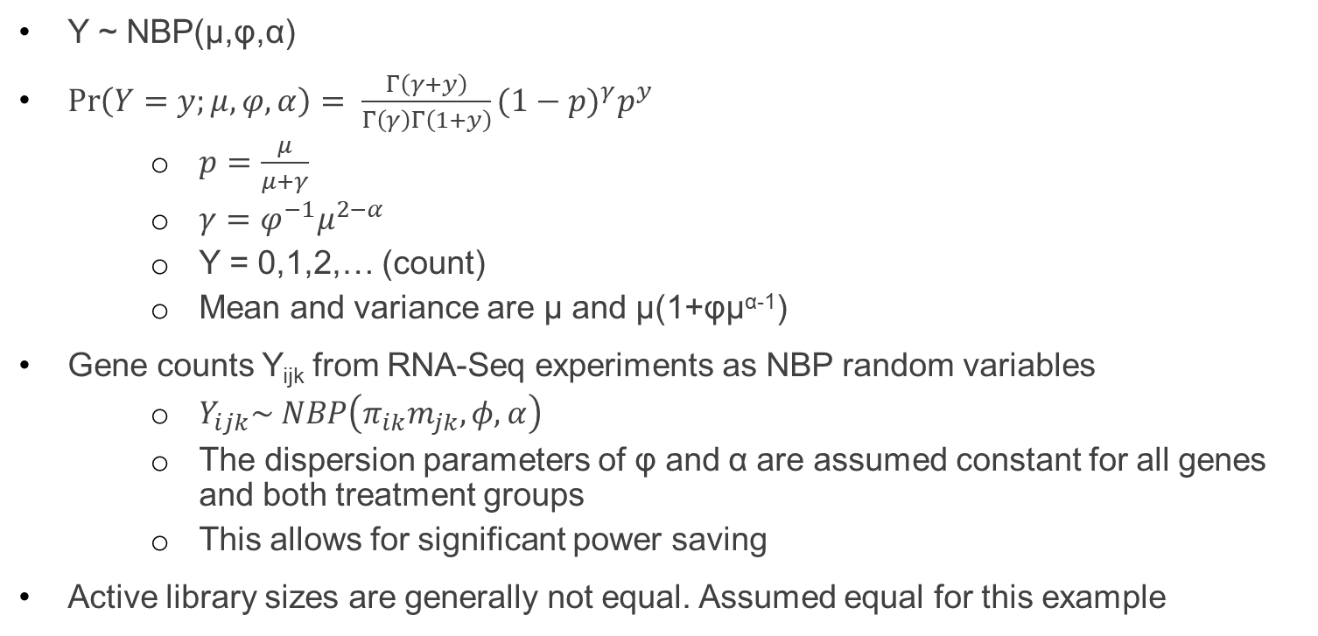
NBP Distribution- PMF
Y ~ NBP(μ,φ,α)
$\operatorname{Pr}\left(Y=y;μ,φ,α\right)= \frac{Γ\left(γ+y\right)}{Γ\left(γ\right)Γ\left(1+y\right)}{(1−p)}^{γ}p^{y}$
$p=\frac{μ}{μ+γ}$
$γ=φ^{−1}μ^{2−α}$
Y = 0,1,2,… (count)
Mean and variance are μ and μ(1+φμ^{α-1})
Gene counts Y_{ijk} from RNA-Seq experiments as NBP random variables
$Y_{ijk}\sim NBP\left(π_{ik}m_{jk},φ,α\right)$
The dispersion parameters of φ and α are assumed constant for all genes and both treatment groups
This allows for significant power saving
Active library sizes are generally not equal. Assumed equal for this example

Slide 21
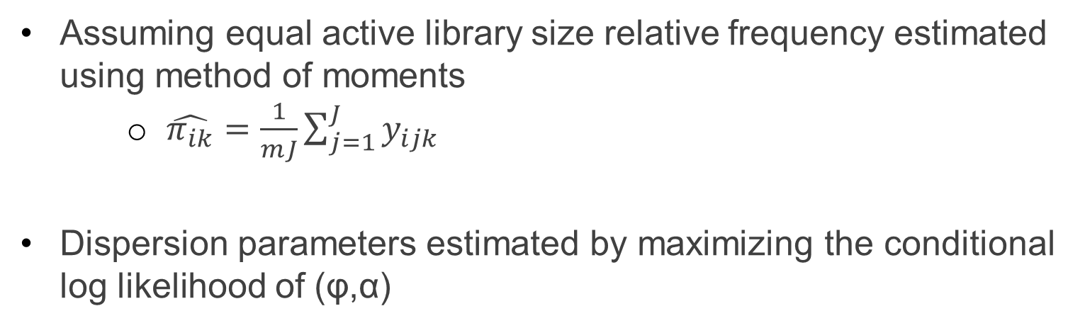
NBP Distribution - Estimates
Assuming equal active library size relative frequency estimated using method of moments
$\hat{π_{ik}}=\frac{1}{mJ}\sum_{j=1}^{J}{y_{ijk}}$
Dispersion parameters estimated by maximizing the conditional log likelihood of (φ,α)

Slide 22
Adaption of the Robison and Smyth and Exact Test

